Slide 1
Chapter 21
Programming with Windows Forms Controls

Slide 2
Objectives
Examining various Windows Forms controls
Building custom controls
Building custom dialogs
Docking and Anchoring behaviors

Slide 3
Content
The world of Windows Forms controls
Working with the basic controls
Configuring the Tab order
Working with more exotic controls
Building custom Windows Forms controls
Building custom Dialog boxes
Dynamically positioning Windows Forms controls

Slide 4
The world of Windows Forms controls
Text controls: TextBox, Label, StatusBar
Command controls: Toolbar, Button, LinkLabel
Selection List controls: ListBox, ComboBox, CheckedListBox, ListView, TreeView, NumericUpDown, DomainUpDown
Value setting controls: CheckBox, RadioButton, TrackBar
Grouping controls: Panel, GroupBox, TabControl
Graphics storage type controls: PictureBox, ImageList

Slide 5
Working with the basic controls
Label, TextBox, and MaskedTextBox
Button
CheckBox, RadioButton, and GroupBox
CheckedListBox, ListBox, and ComboBox

Slide 6
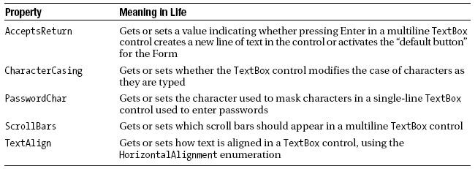
Working with the basic controls
Label controls: hold read-only information
TextBox controls: allow to enter textual data

Slide 7
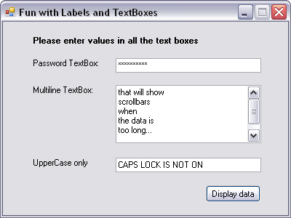
Working with the basic controls

Slide 8
Working with the basic controls
MaskedTextBox controls
  Allow to specify a valid sequence of characters that will be accepted by the input area (Social Security number, phone number with area code, zip code, or whatnot).
  The mask to test against is established using specific tokens embedded into a string literal.

Slide 9
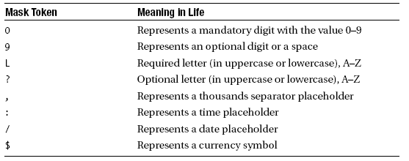
Working with the basic controls
Tokens of MaskedTextBox control

Slide 10
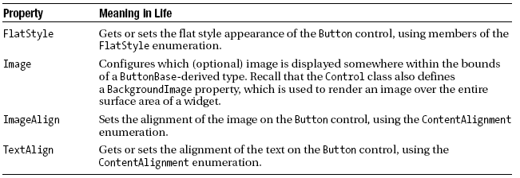
Working with the basic controls
Button controls
  ButtonBase Properties
  Example: Buttons

Slide 11
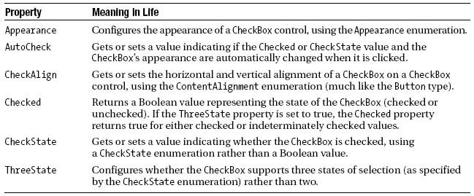
Working with the basic controls
CheckBox controls

Slide 12
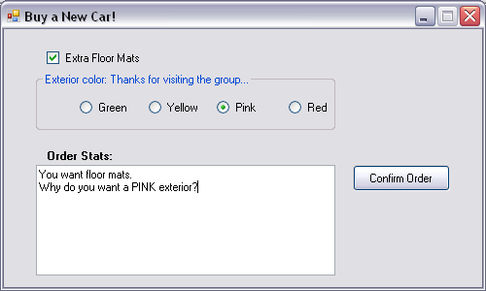
Working with the basic controls
CheckBox, RadioButton and GroupBox controls

Slide 13
Working with the basic controls
CheckedListBox
ComboBox controls
  Allow to make a selection from a well-defined set of possibilities.
  Users can also insert additional items
ListBox

Slide 14
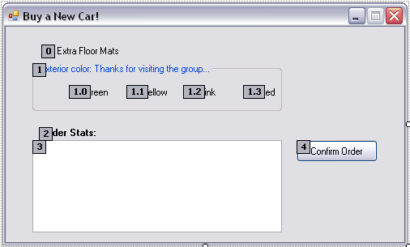
Configuring the Tab order

Slide 15
Working with more exotic controls
MonthCalendar
ToolTip
TabControl
TrackBar
Panel
UpDown controls
ErrorProvider
TreeView
WebBrower

Slide 16
Working with more exotic controls
MonthCalendar controls: allow to select a date (or range of dates) using a friendly UI
DateTimePicker controls expose a MonthCalendar from a DropDown control
Panel controls
  Are used to group related controls in a logical unit
  Can support scroll bars

Slide 17
Working with more exotic controls
Spin controls
  DomainUpDown: allows to select from a set of string data
  NumericUpDown control: allow selections from a range of numeric data points

Slide 18
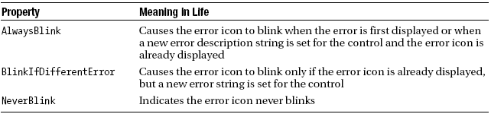
Working with more exotic controls
ErrorProvider controls
  Can be used to provide a visual cue of use input error
  CausesValidation property
  Validating events: is used to configure a corresponding ErrorProvider
  Validated events: is used to determine when the control finished its validation cycle

Slide 19
Building custom Windows Forms controls
Build a new class deriving from UserControl and
Populate the type with any number of properties, methods, and events

Slide 20
Building custom Dialog boxes
A dialog is simply a stylized Form
  FormBorderStyle is FixedDialog
  MinimizeBox and MaximizeBox are false
  ShowInTaskbar is false
The DialogResult Property
  Abort, Cancel, Ignore, No, None, OK, Retry, Yes
  Allow the parent Form to determine which selected button

Slide 21
Dynamically positioning Windows Forms controls
By default, the controls are rendered using absolute position
The Anchor property
  is used to define a relative fixed position in which the control should always be rendered
The Dock property
  configure which sides of a Form the widget should be attached to

Slide 22
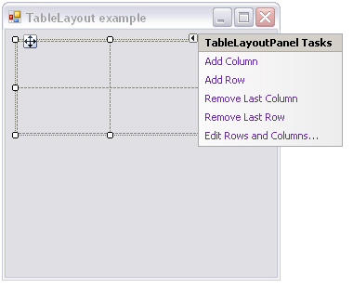
Dynamically positioning Windows Forms controls
Table and Flow Layout
  can be docked into a Form’s client area to arrange the internal controls.

Slide 23
Summary
Examining the programming of numerous GUI widgets, from the simple to the more exotic
The construction of custom controls
How to build custom dialog boxes
Exploring the various anchoring and docking behaviors

Slide 24
Q & A

